Slide 1


CAR PRICE PREDICTION PROJECT
Presented by:
Shubham Nalawade

Slide 2
INTRODUCTION
With the covid 19 impact in the market, we have seen lot of changes in the car market.
Now some cars are in demand hence making them costly and some are not in demand hence cheaper.

Slide 3
PROBLEM STATEMENT
One of our clients works with small traders, who sell used cars. With the change in market due to covid 19 impact, our client is facing problems with their previous car price valuation machine learning models.
So, they are looking for new machine learning models from new data. We have to make car price valuation model.

Slide 4
Tools Used
Anaconda 2020.07 Jupyter Notebook 6.0.3 Python 3.8.3 Numpy Pandas | Scikit Learn Matplotlib Warnings Seaborn Machine Learning

Slide 5
Model Designing Procedure
Web Scraping from Cars24.com
Exploratory Data Analysis (EDA) of Scrapped Data
Visualization
Removal of Outliers and Skewness
Preparing Input and Target Variables
Model Designing, Evaluation and Finalization
Conclusion

Slide 6
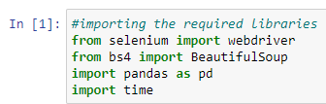
WEB SCRAPING FROM CARS24.COM
Importing Important Libraries such as Pandas, Selenium, BeautifulSoup and time for Web Scraping.
Defining Functions for Web Scraping from Cars24.com

Slide 7
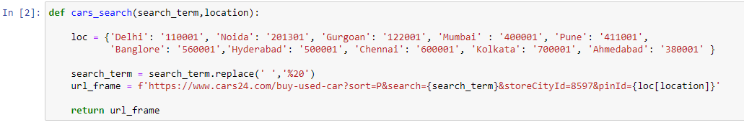
Function for Car Search:

Slide 8
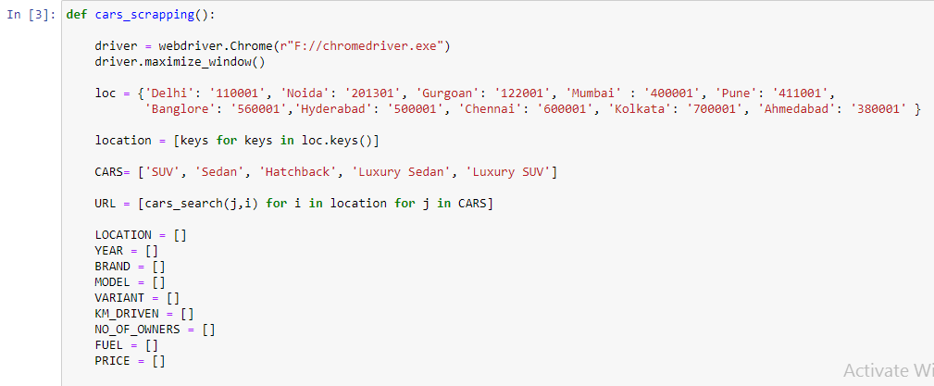
Function for Web Scraping includes the calling of car search function::

Slide 9
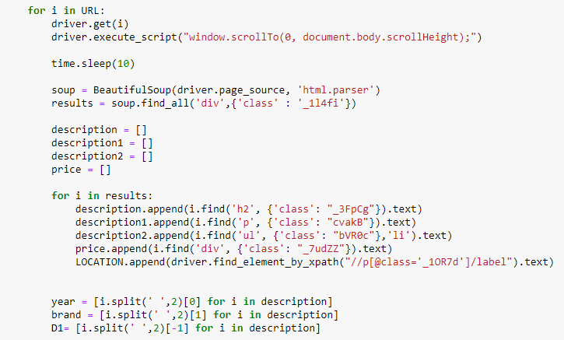

Slide 10
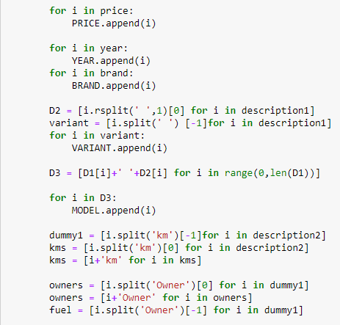

Slide 11
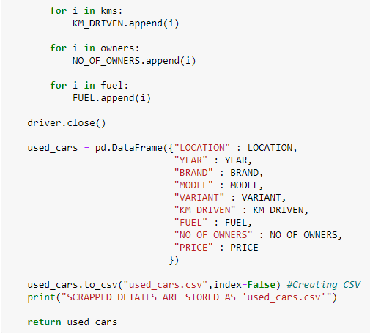

Slide 12
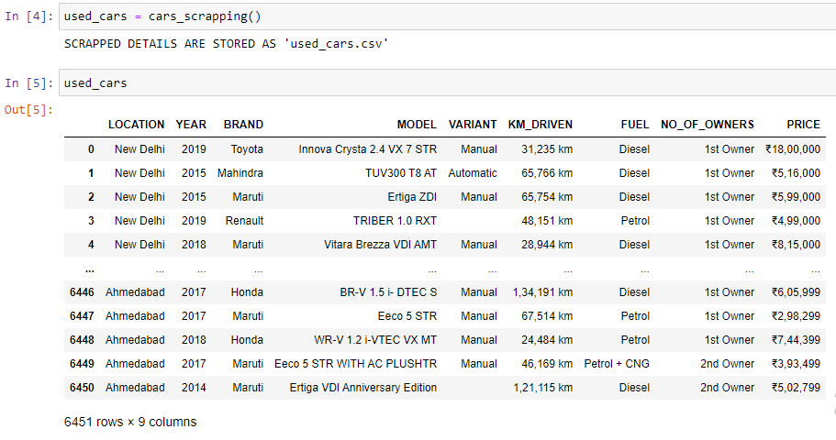
Calling the Web Scraping Function and Data scraped:

Slide 13
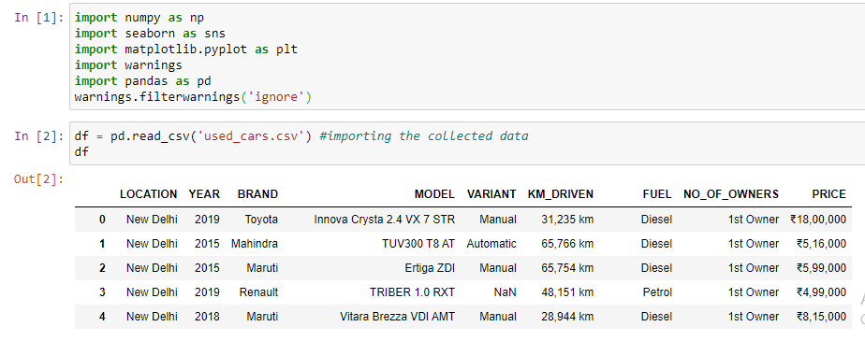
Exploratory Data Analysis (EDA)
Importing Libraries and Loading Dataset:

Slide 14
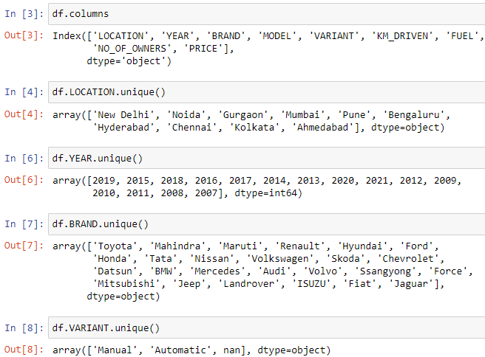
Observing Unique Values of each feature:

Slide 15
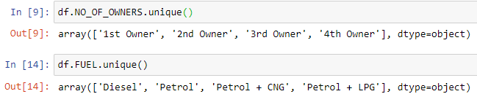

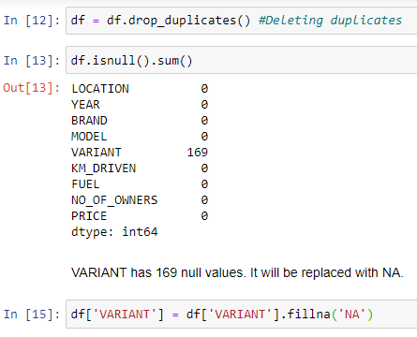
Deleting Duplicate Values and Replacing Null Values:

Slide 16
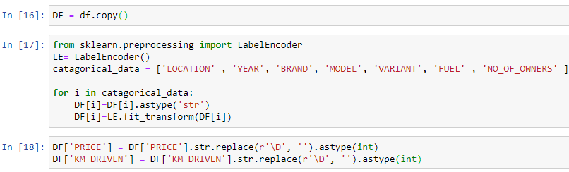
Label Encoding:

Slide 17
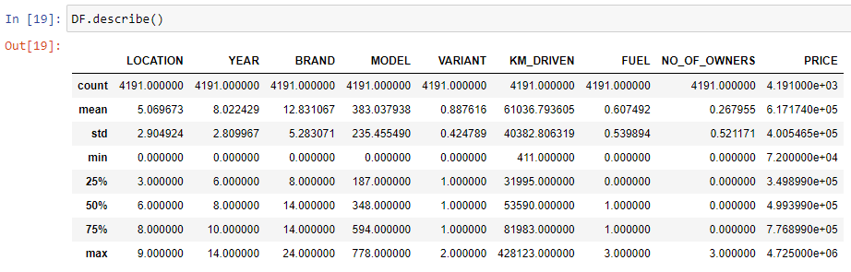
Data Description:

Slide 18
VISUALIZATION

Slide 19
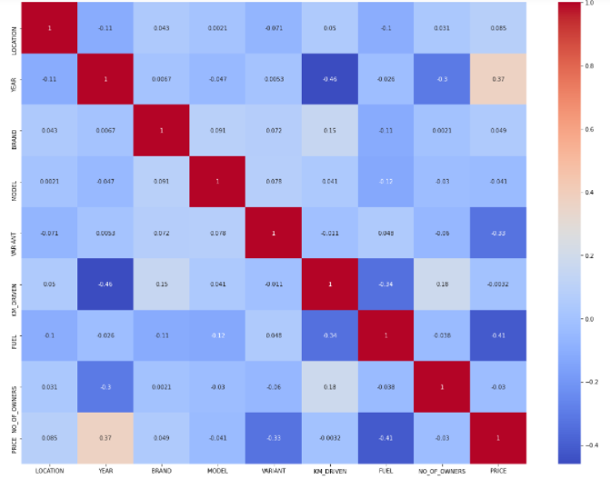
Correlation between all Features:

Slide 20
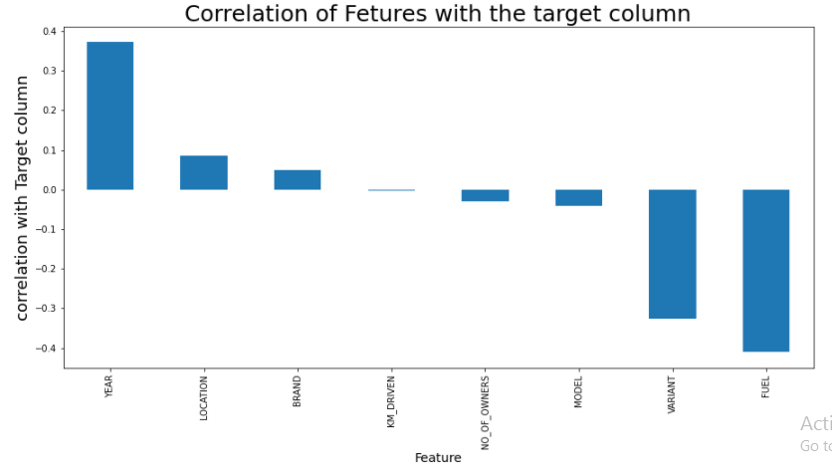
Correlation between Features with Target Variable ie Price:

Slide 21
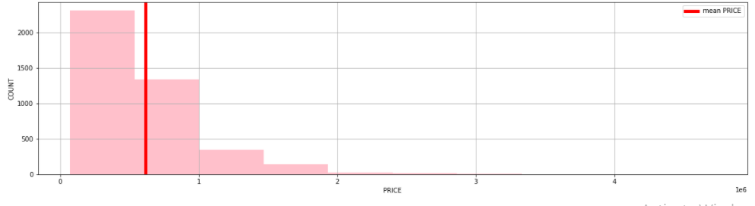
Distribution of Price:
Mean of the price is Rs: 6,17,174, the price is distributed between Rs: 72,000 to Rs: 47,25,000.
Most of the Car price is leser than the Mean i.e Rs: 6,17,174.

Slide 22
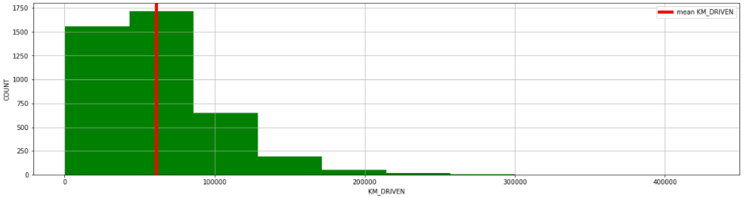
Distribution of Kms Driven:
Mean of the KM_DRIVEN is 61036.79 kms and the maximum KMS driven is 428123 kms.
Most of the Cars comes to selling around below 61036 kilometers driven.

Slide 23
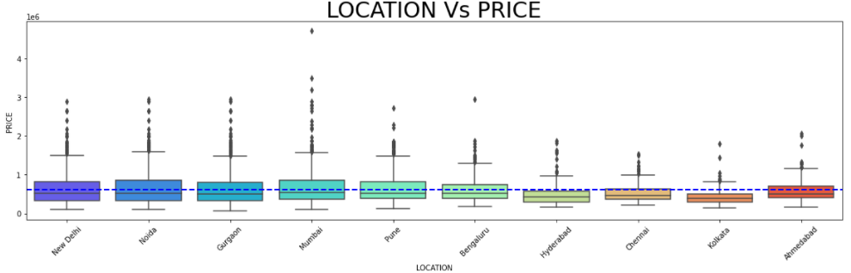
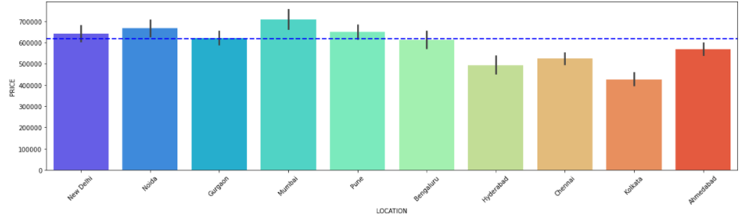

Slide 24
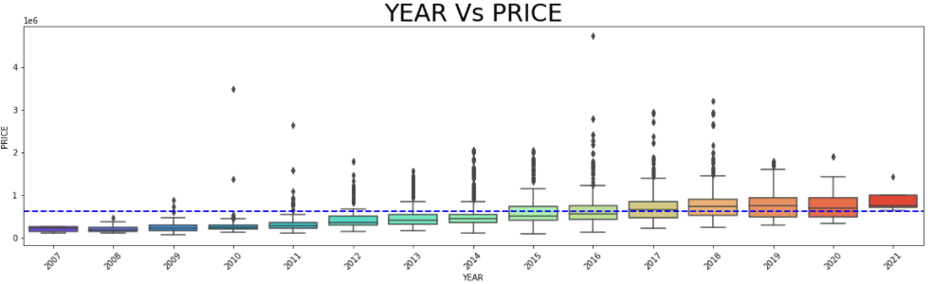
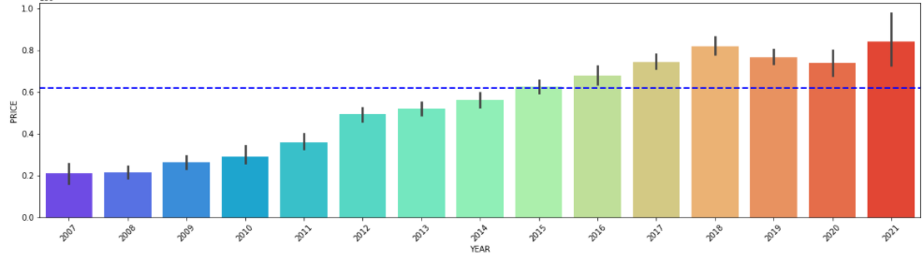

Slide 25
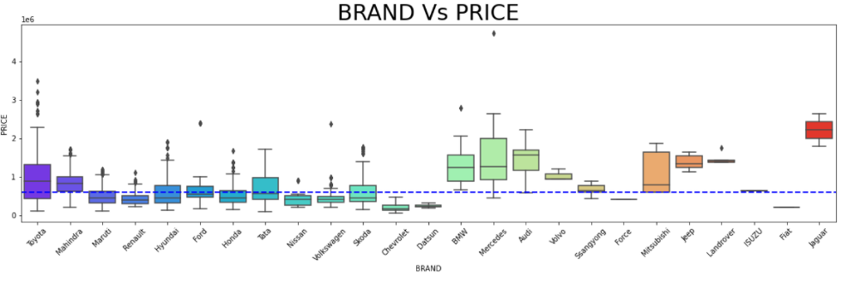
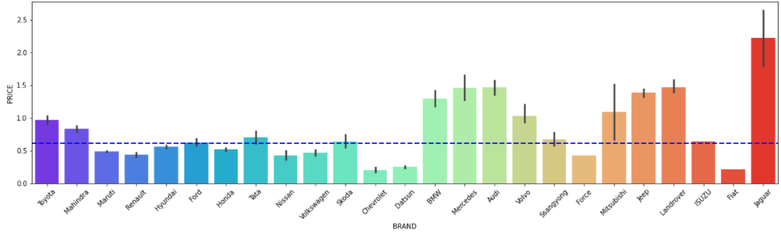

Slide 26
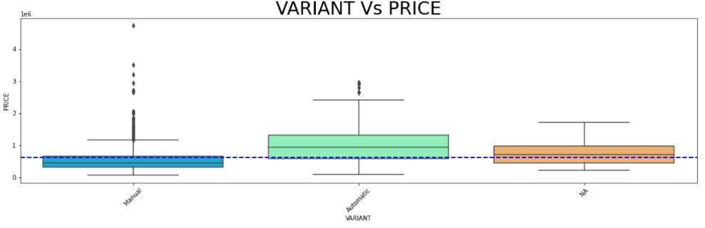
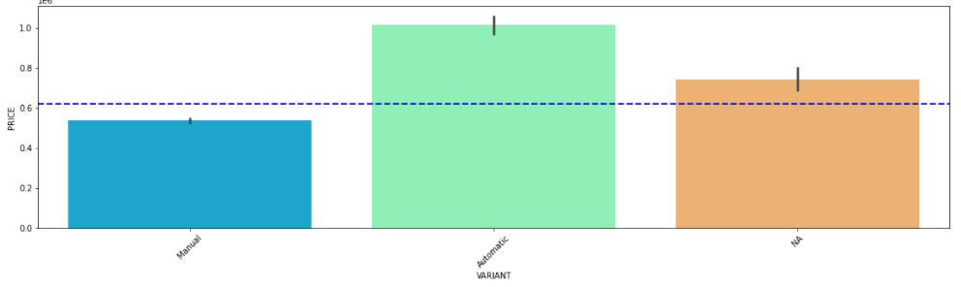

Slide 27
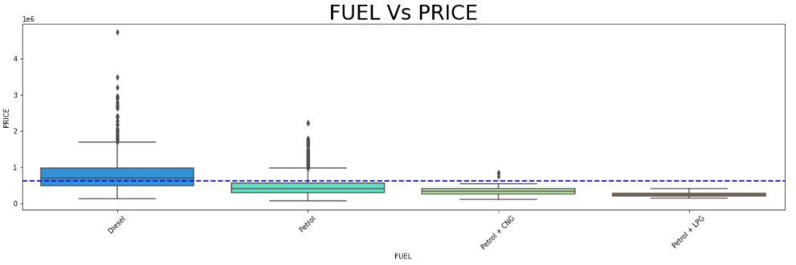
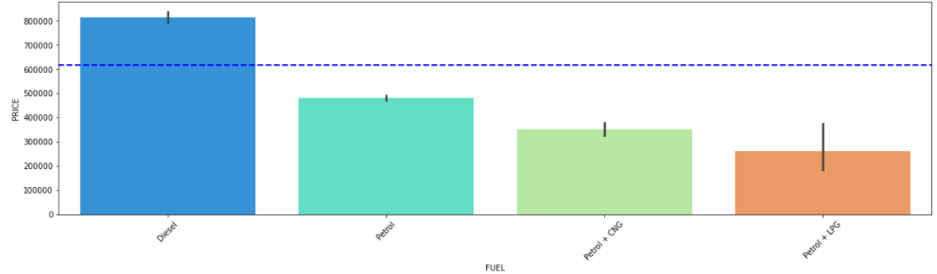

Slide 28
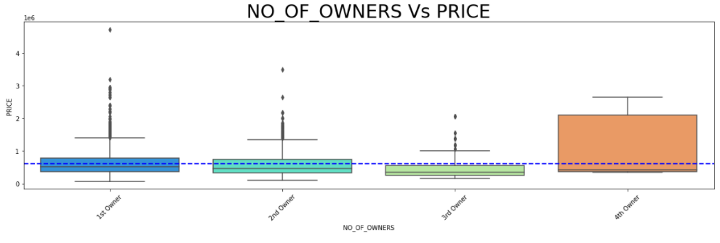
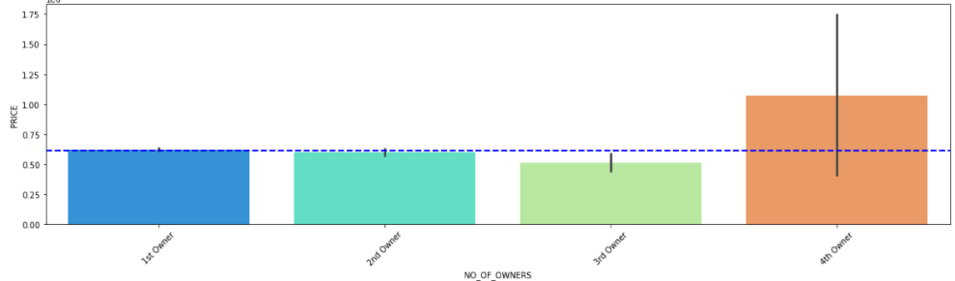

Slide 29
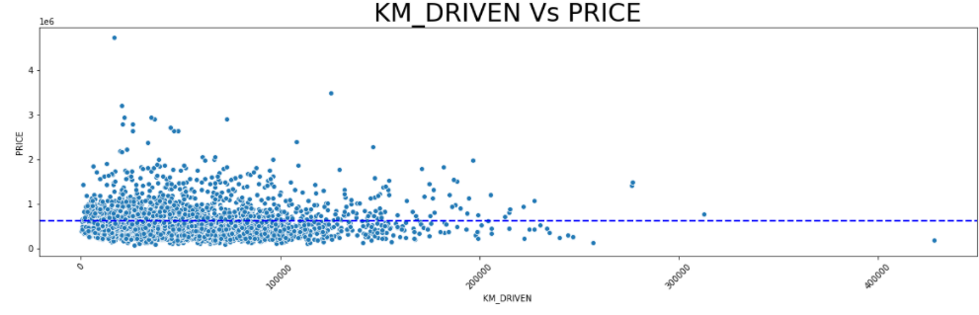

Slide 30
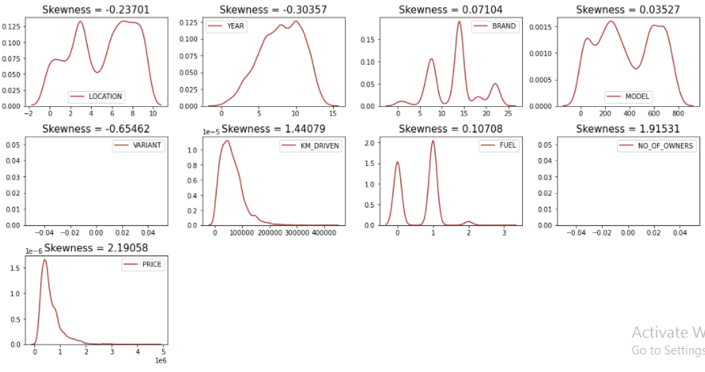
Removal of Outliers and Skewness

Slide 31
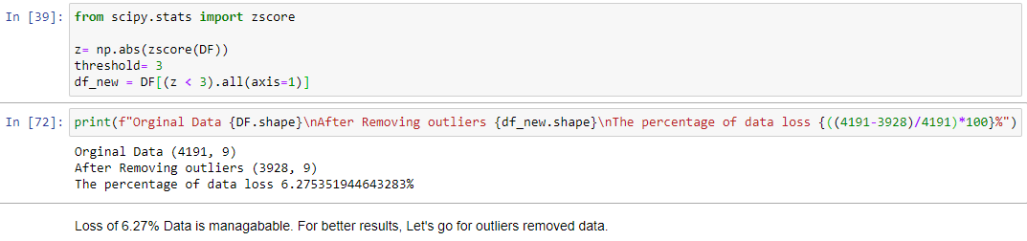
Removing Outliers:

Slide 32
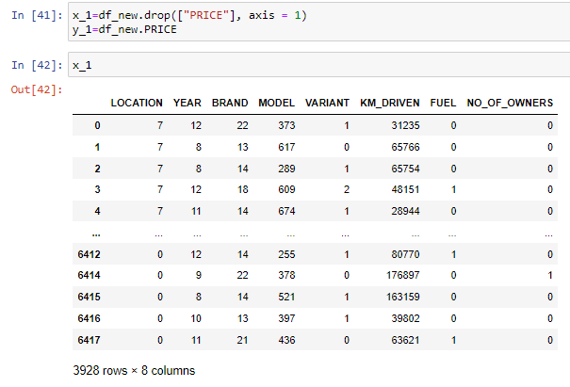
Preparing Input and Target Variables
Input Variable and Scaling:

Slide 33
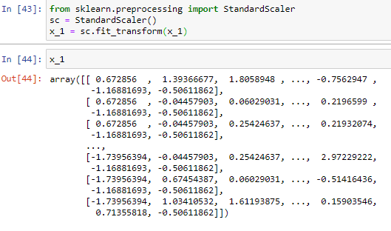

Slide 34
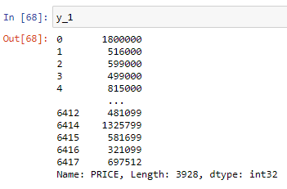
Target Variable:

Slide 35
Model Designing, Evaluation and Finalization

Slide 36
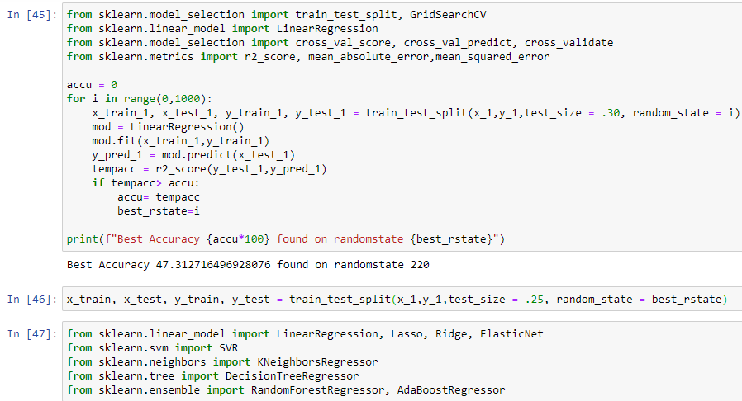
Importing Machine Learning Algorithms like Linear Regression, SVR, Decision Tree Regressor, KNeighborRegressor, Random Forest Regressor etc.

Slide 37
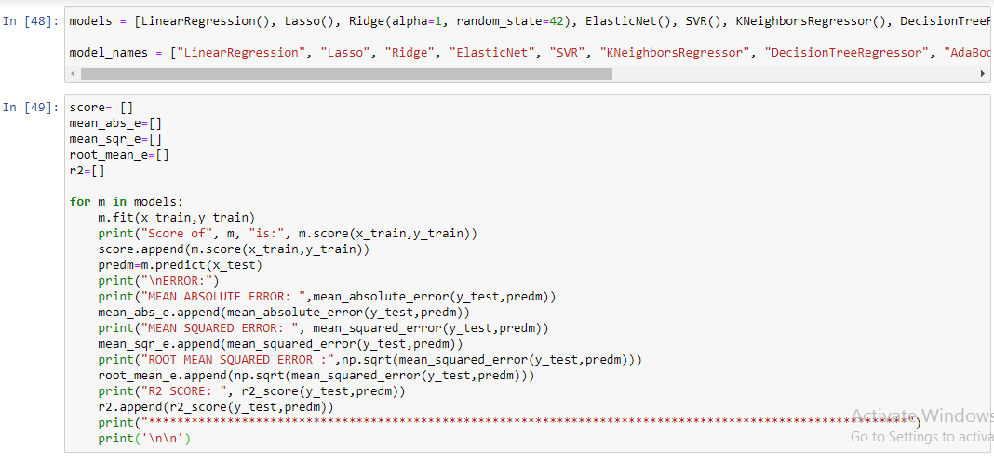
Model Building:

Slide 38
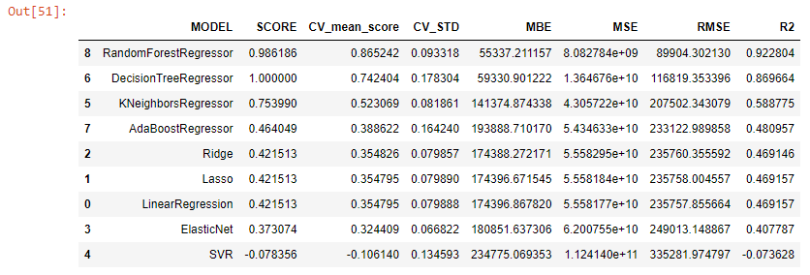
Model Evaluation Results:
On the basis R2 Score RandomForestRegressor Model is best.

Slide 39
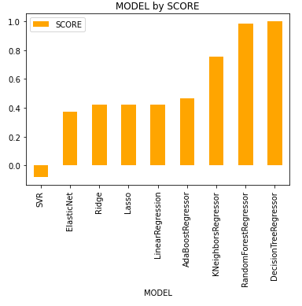
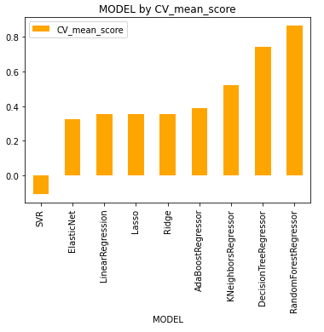
Graphical Representation of Model Evaluation:

Slide 40
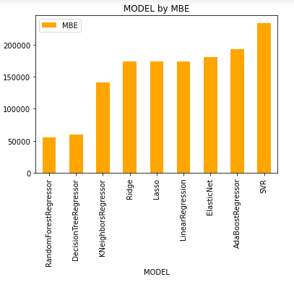
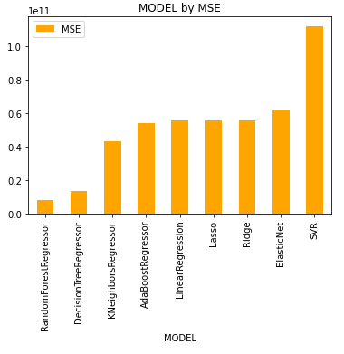

Slide 41
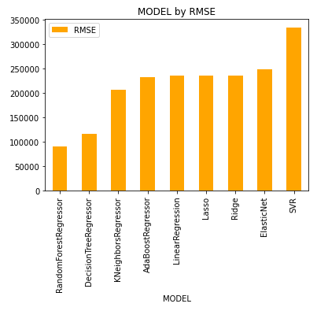
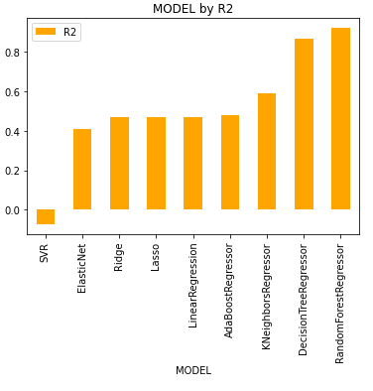

Slide 42
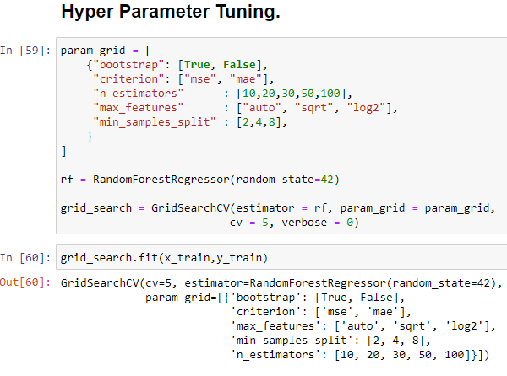
Hypertuning:

Slide 43
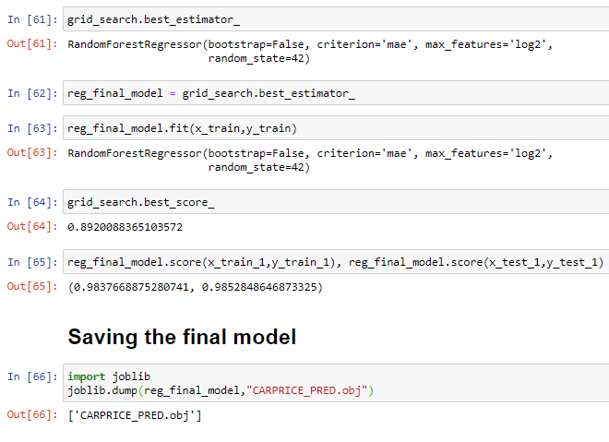
Using Best Parameters obtained from Hypertuning Predicting Prices of test data and Model Saving.

Slide 44
CONCLUSION
The manufacturer like Land Rover, Benz, BMW cars are costliest used car in the market comparatively to other cars.
The low kilometres driven and also if the manufacturing year is lesser on these brands those cars sales are in much higher rates or closest to the buying new car rates.
The Diesel variant and Automatic shift variants are also costliest user car variants in the used car market.

Slide 45


